Slide 1


Natural language processing to capture person-first or identity-first language

Slide 2
Who we are:
Professor Ramona Moldovan
University of Manchester, UK
Babeș-Bolyai University, Romania
Ramona.Moldovan@mft.nhs.uk
Dr. Julia Kasmire
Cathie Marsh Institute University of Manchester, UK
UK Data Service
J.Kasmire@manchester.ac.uk
@JKasmireComplex
Dr. Andrada Ciucă
Babeș-Bolyai University, Romania
andradaciuca@psychology.ro

Slide 3
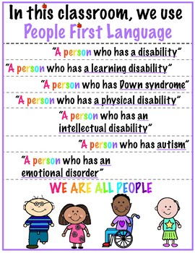
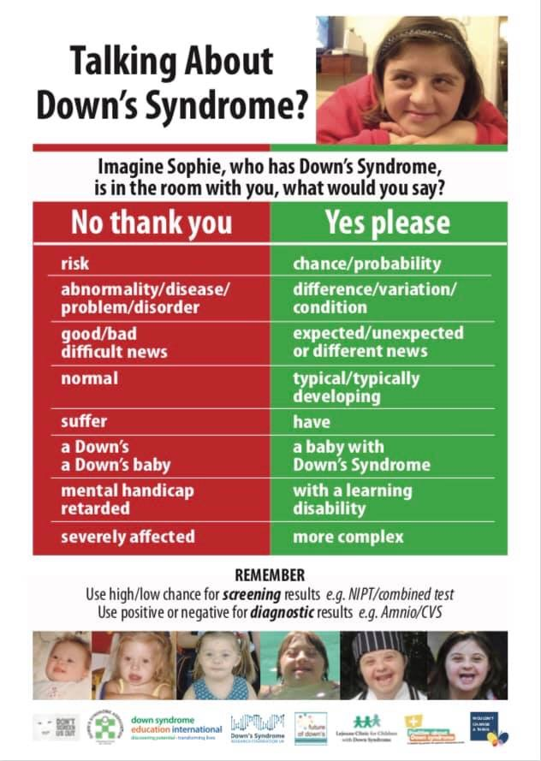
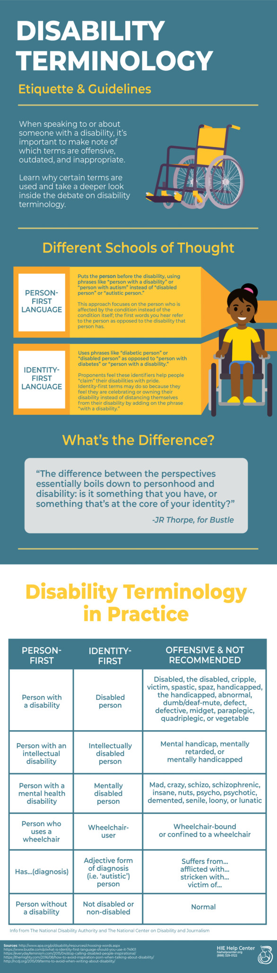
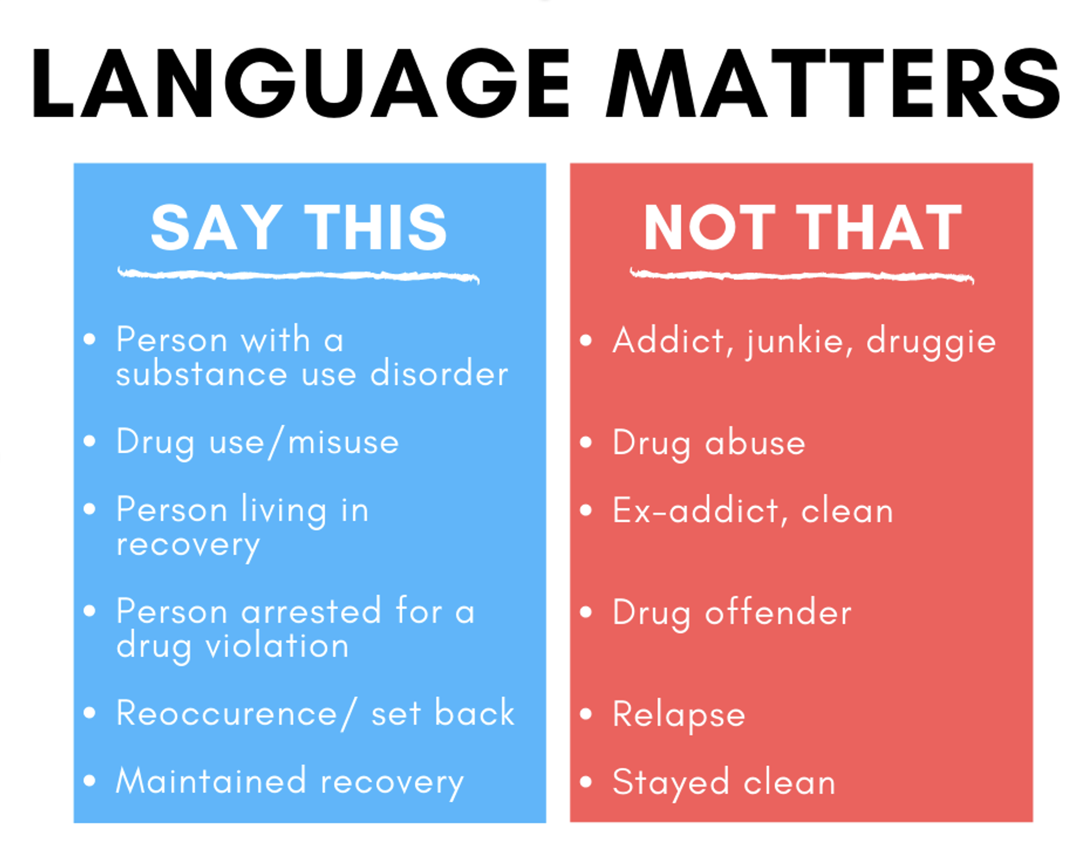

Slide 4

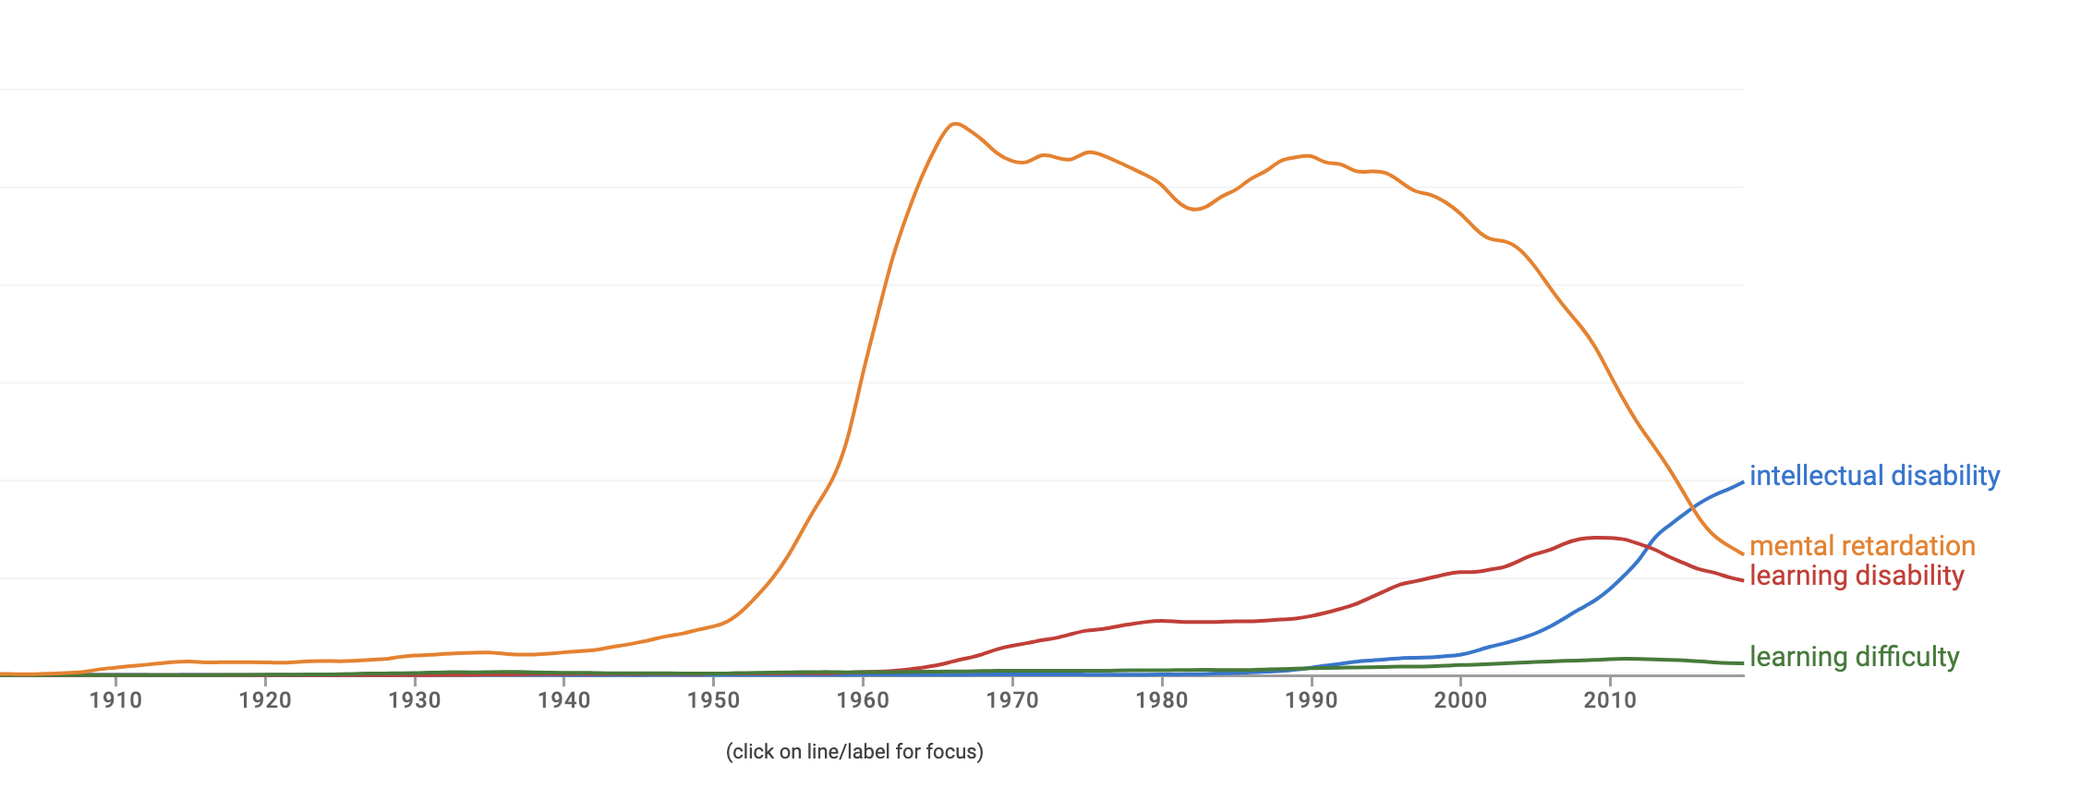

Slide 5
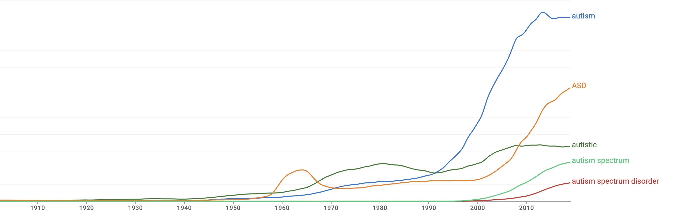

Slide 6
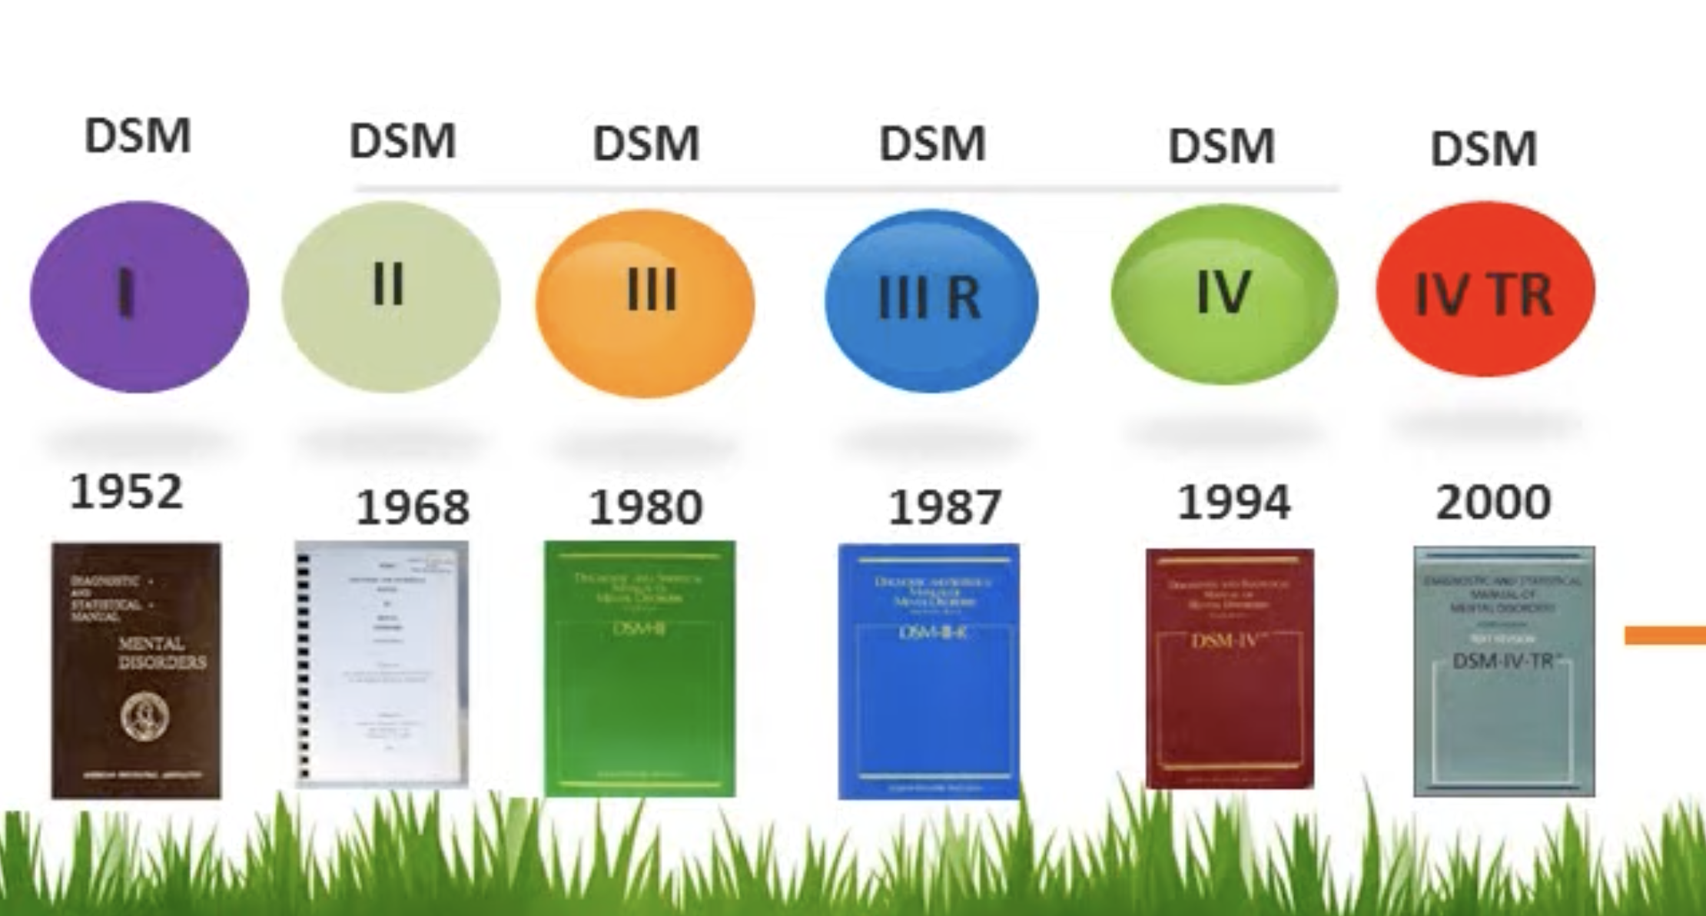

Slide 7
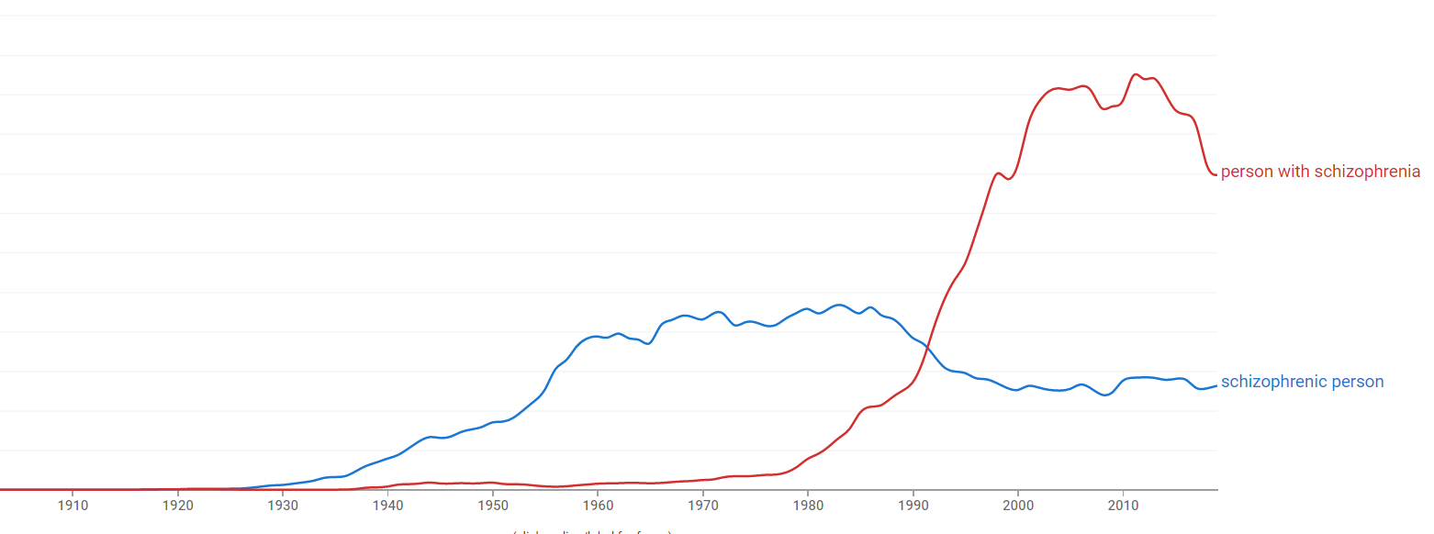

Slide 8
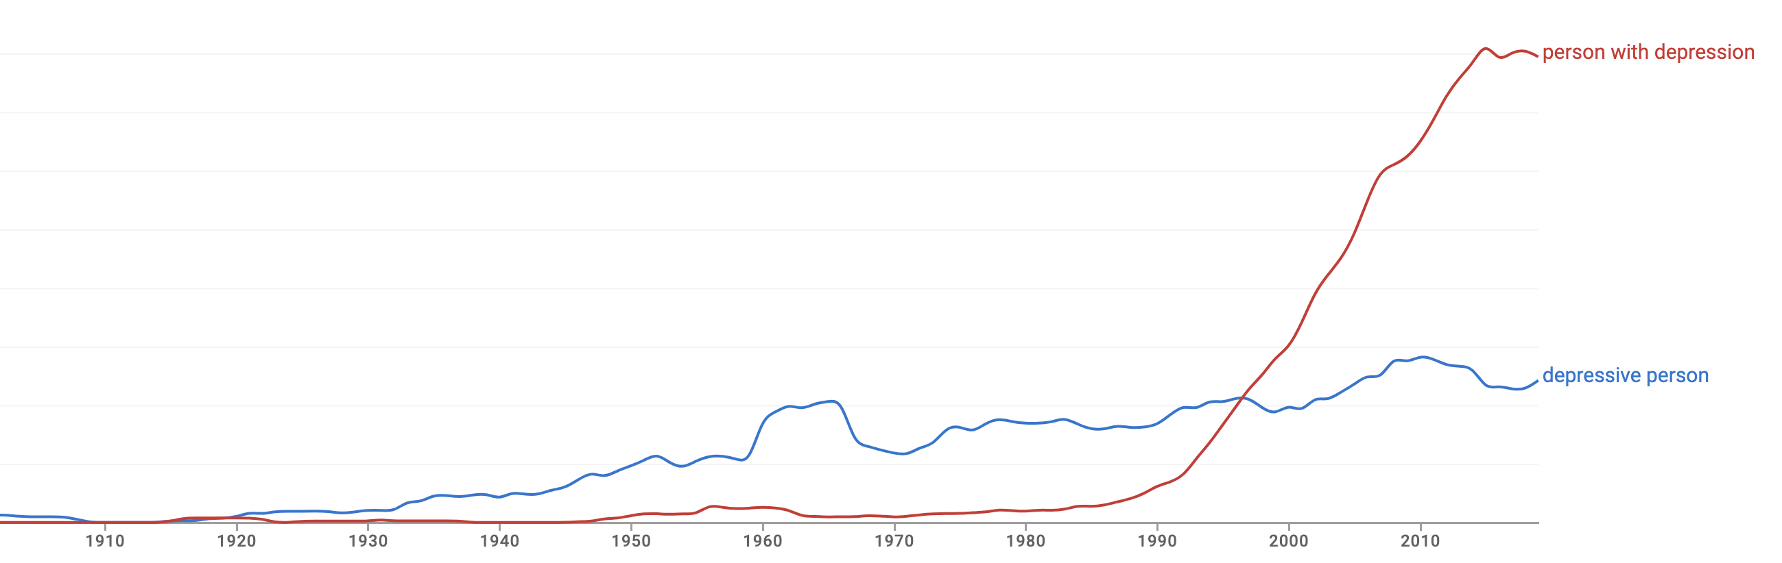

Slide 9
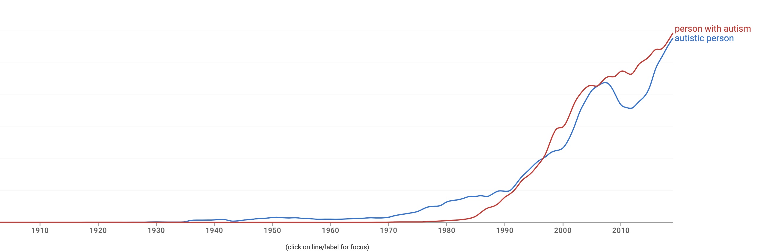

Slide 10
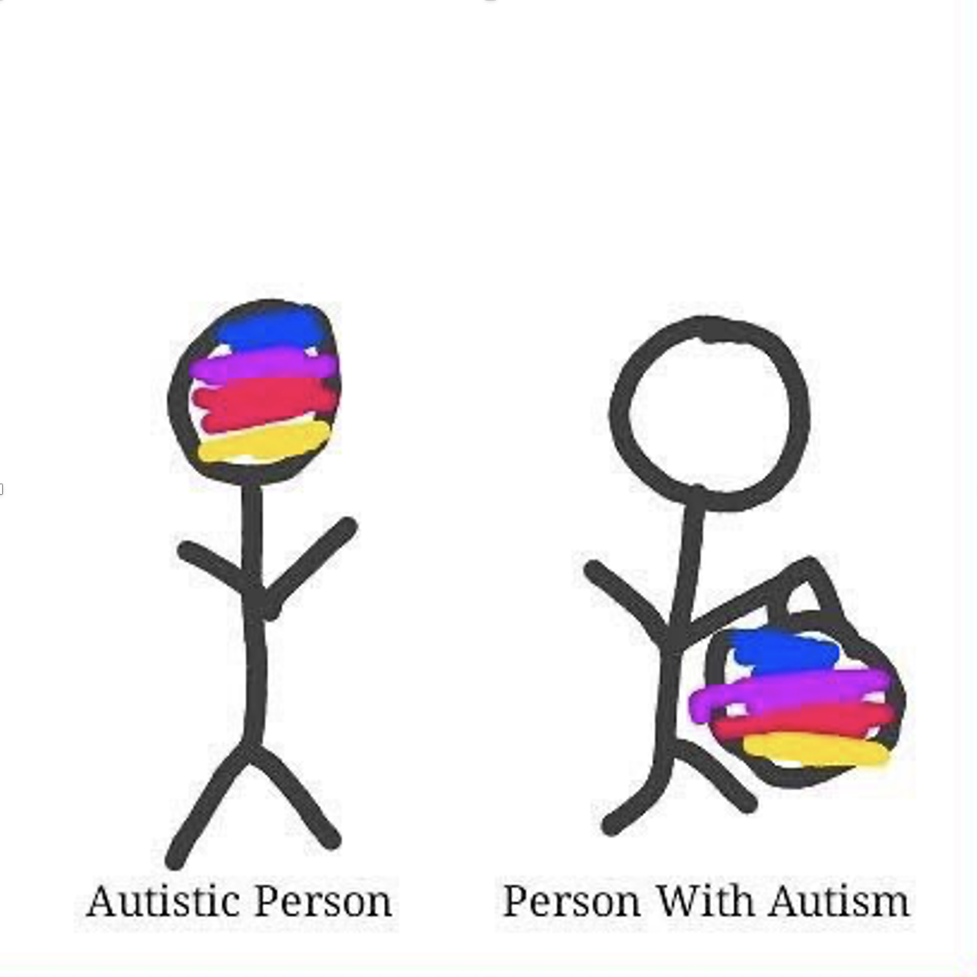

Slide 11
Person First Language
Person-first language (‘70s) proposed to highlight that disability is one component of a person’s identity, rather than the defining feature
Describes what a person has, rather than what a person is
*person with autism

Slide 12
Identity First Language
Describes what a person is, rather than what a person has
Some traits/conditions may be identity-defining features that cannot be separated from the individual & person first language might in fact perpetuate stigmatising views
*autistic person
Notes:
Various conditions are/should be portrayed as neutral (or even positive) attribute, and not a medical problem that requires cure

Slide 13
Euphemism treadmill
Process by which euphemisms become negative, pejorative, or taboo

Slide 14
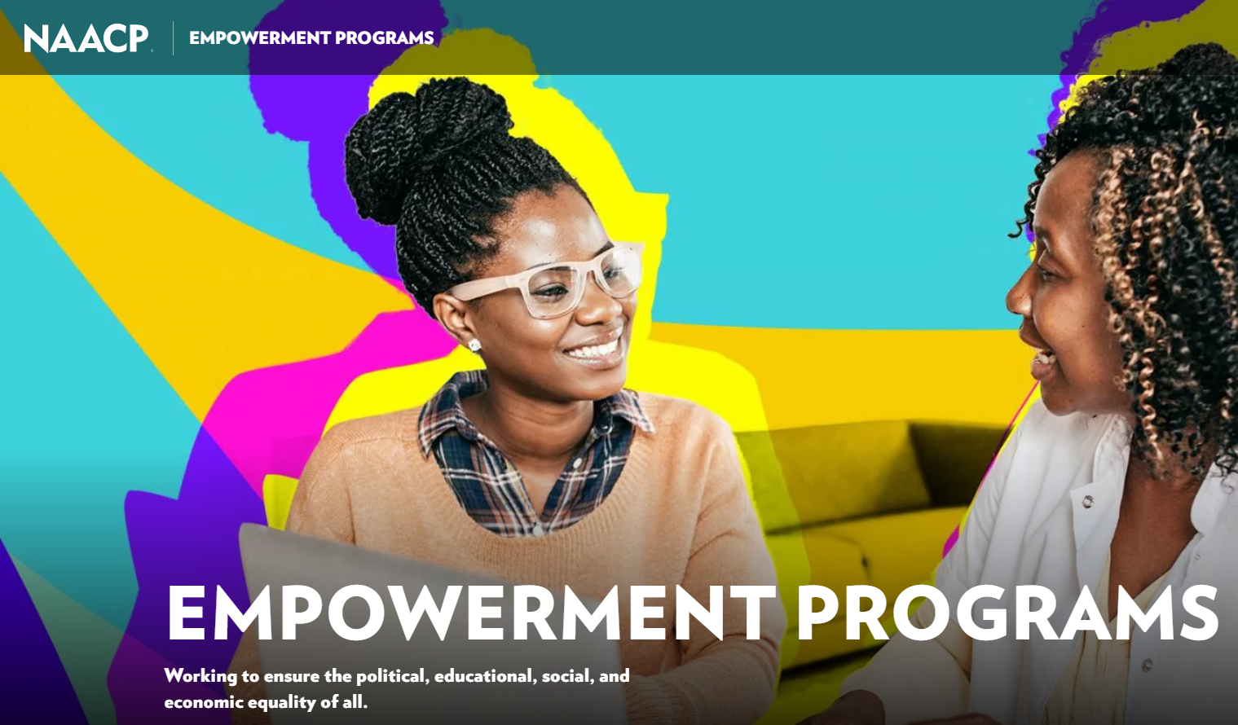
Euphemism treadmill example

Slide 15
Reclaiming euphemisms?
Sometimes people prefer the “offensive” terms
țigan / tzigane
More negative connotations than “roma” but used by some members to refer to themselves without offence
queer
Originally meaning “strange” or “peculiar”, then used as a pejorative, later reclaimed as a deliberatively provocative term

Slide 16
What wording do you tend to use?
Autistic person Person with autism

Slide 17
What wording do you tend to use?
British person Person with Britishness

Slide 18
What wording do you tend to use?
Heterosexual person Person with heterosexuality

Slide 19
What wording do you tend to use?
Diabetic people People with diabetes

Slide 20
What wording do you tend to use?
Deaf person
Person with deafness
Person with hearing loss
Hearing impaired person
Person with hearing impairment

Slide 21
What wording do you tend to use?
Infertile couples Couples with infertility issues

Slide 22
What wording do you tend to use?
Person with brown eyes Brown eyed person

Slide 23
What wording do you tend to use?
People with dwarfism
Dwarf
People of short stature
Short statured people
People with achondroplasia
Little people

Slide 24
What wording do you tend to use?
Intelligent person Person with intelligence

Slide 25
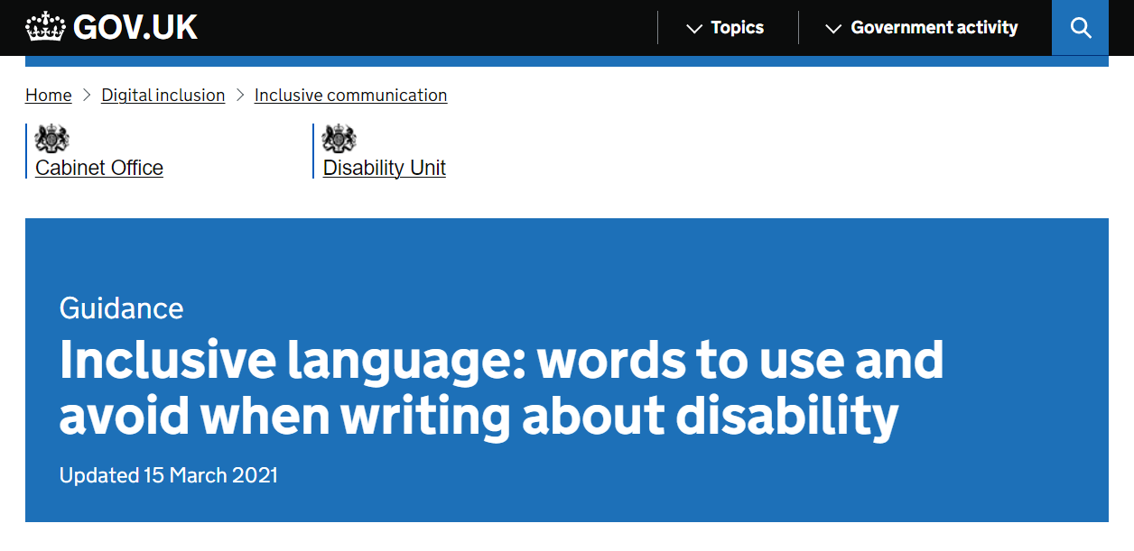


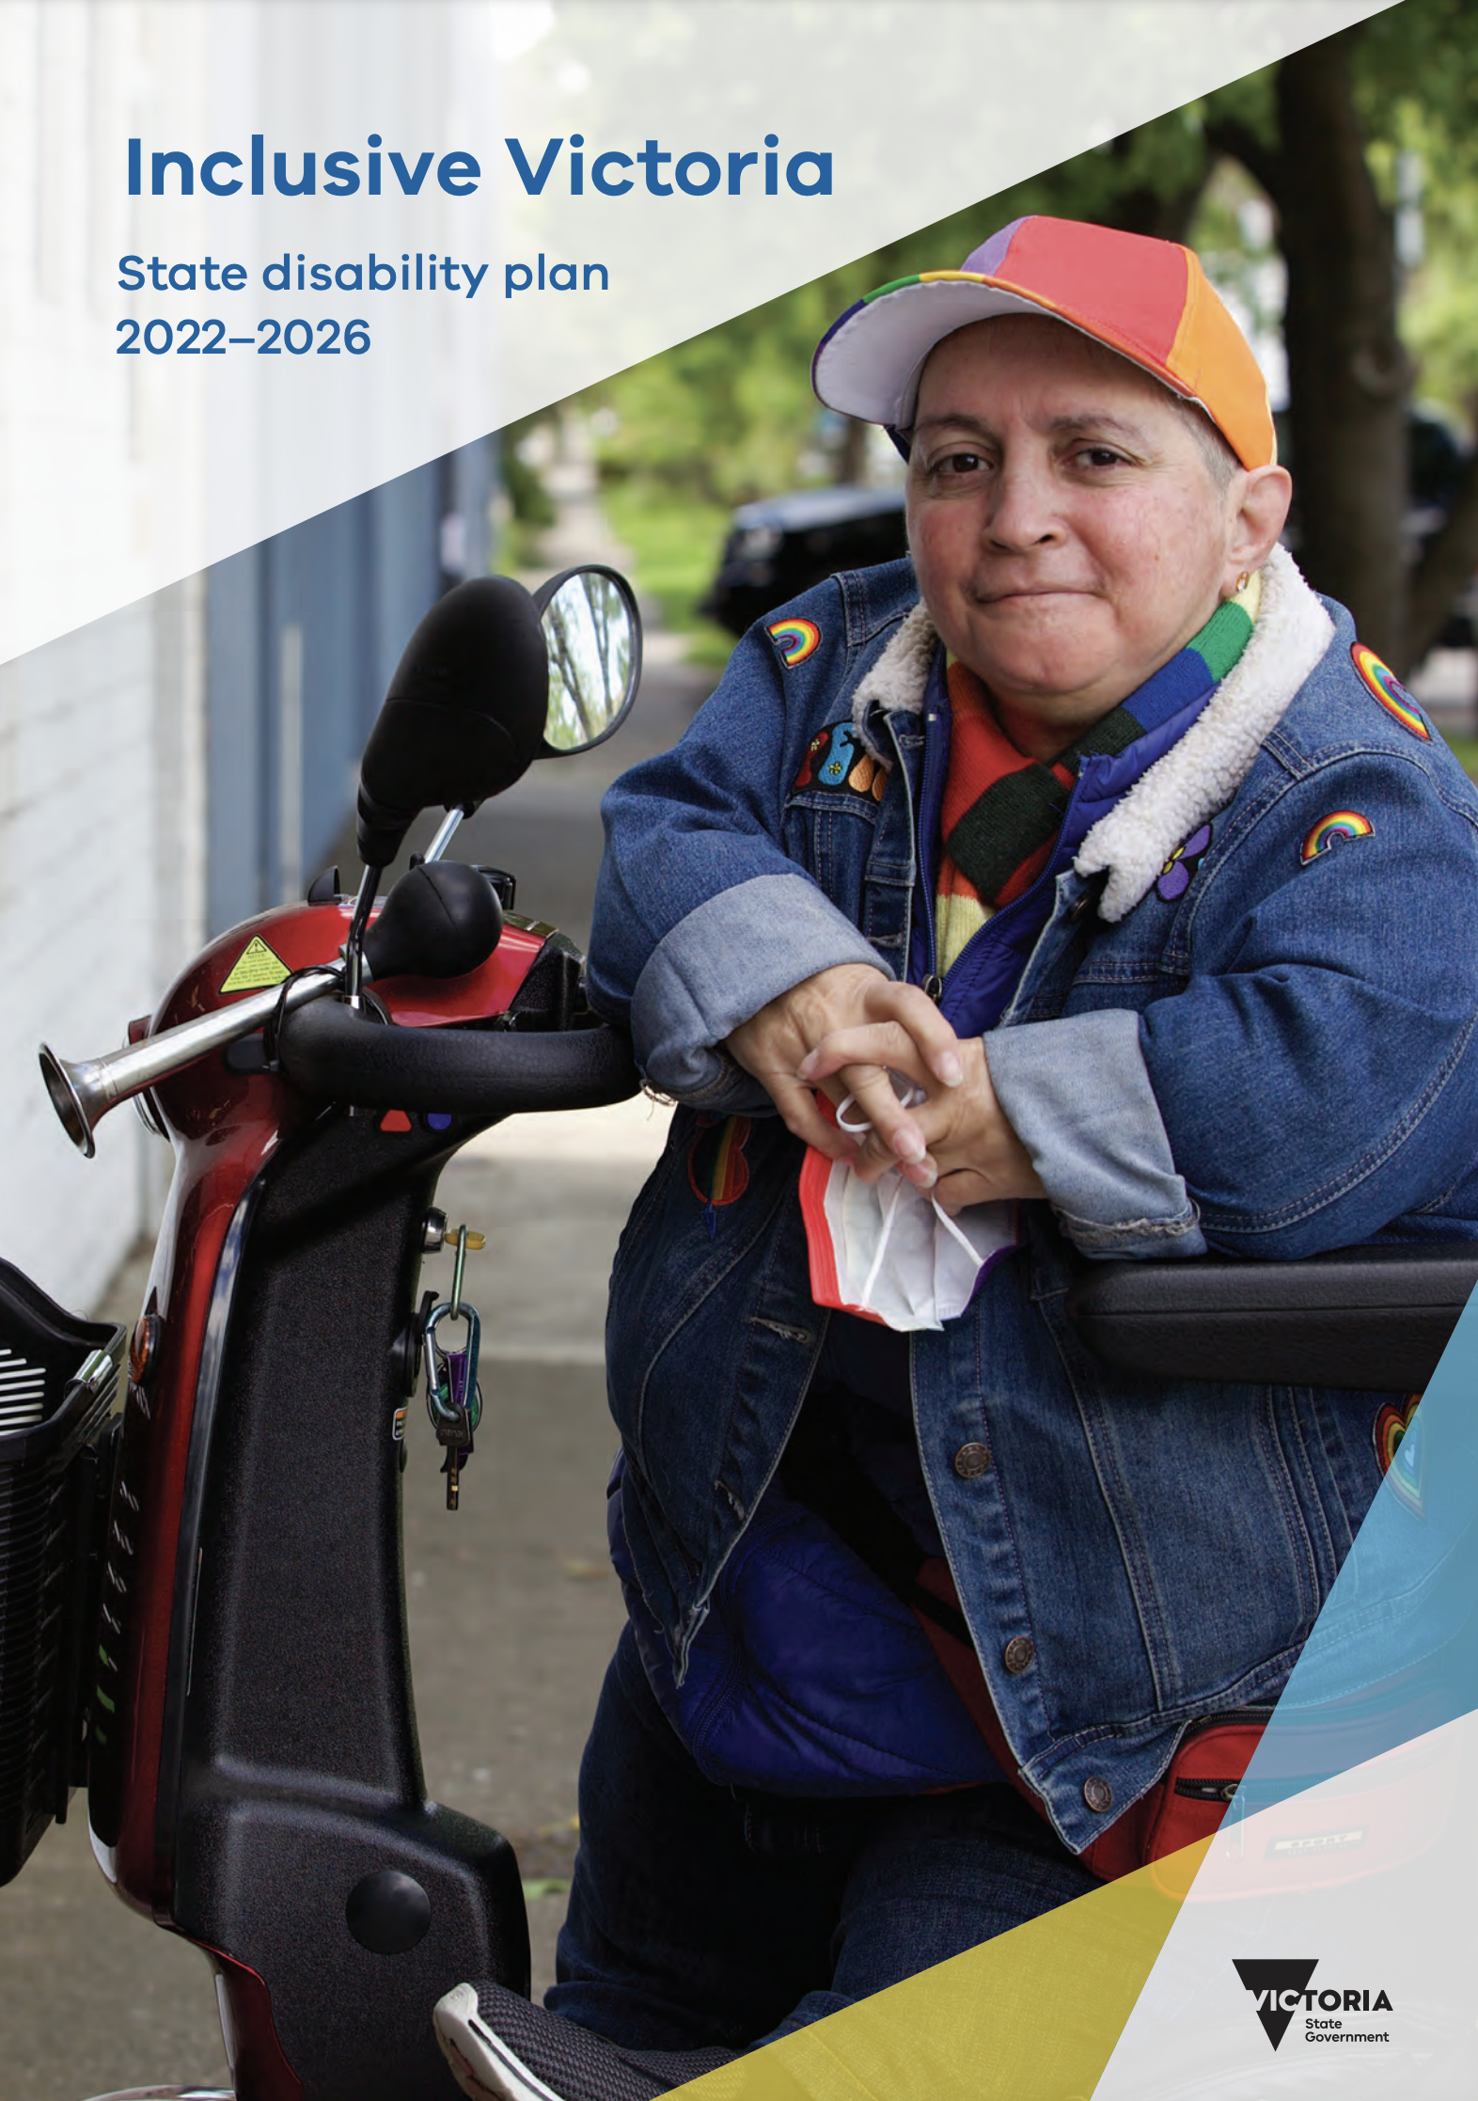
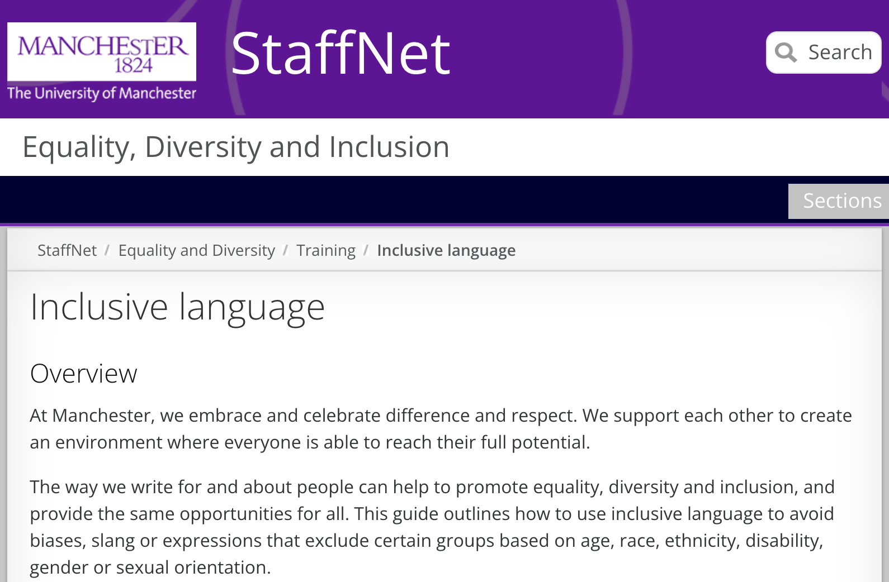

Slide 26
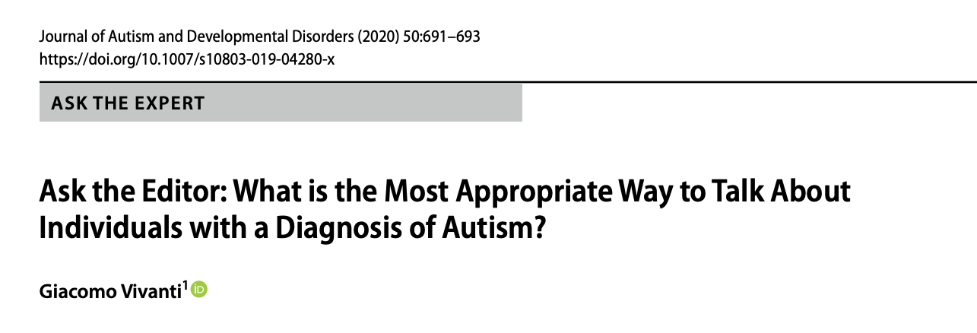
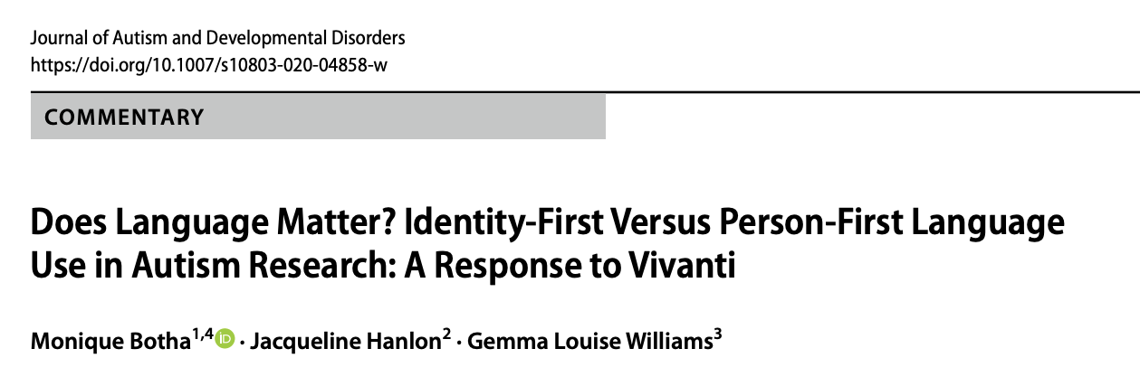
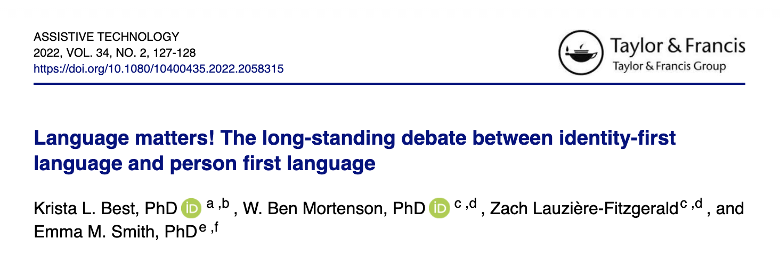

Slide 27
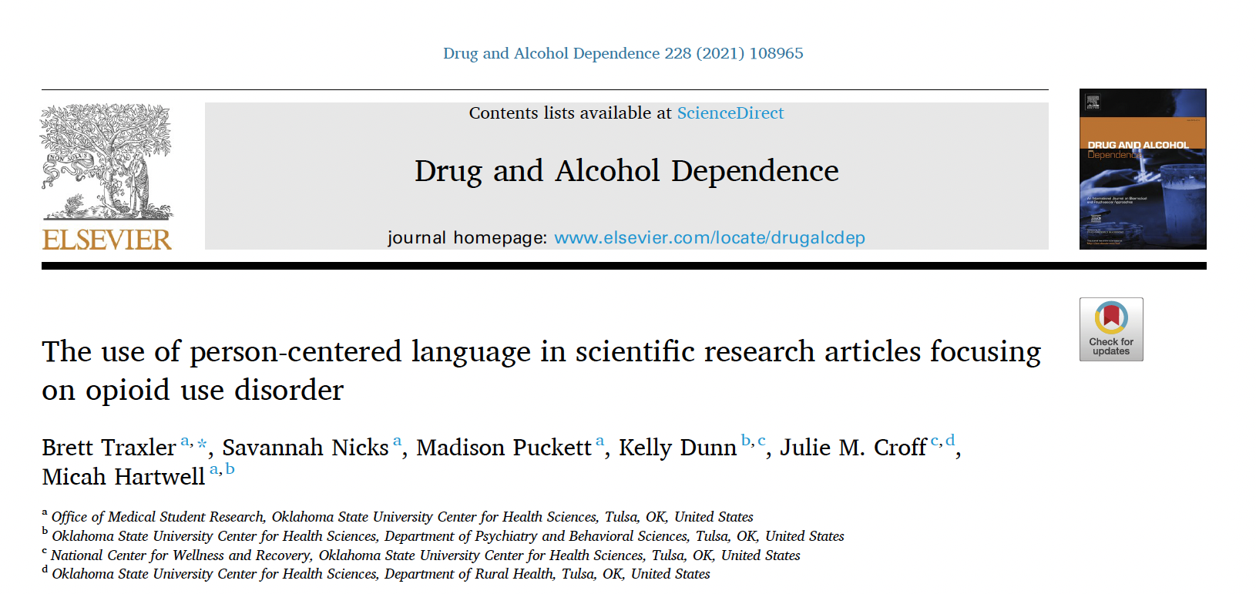
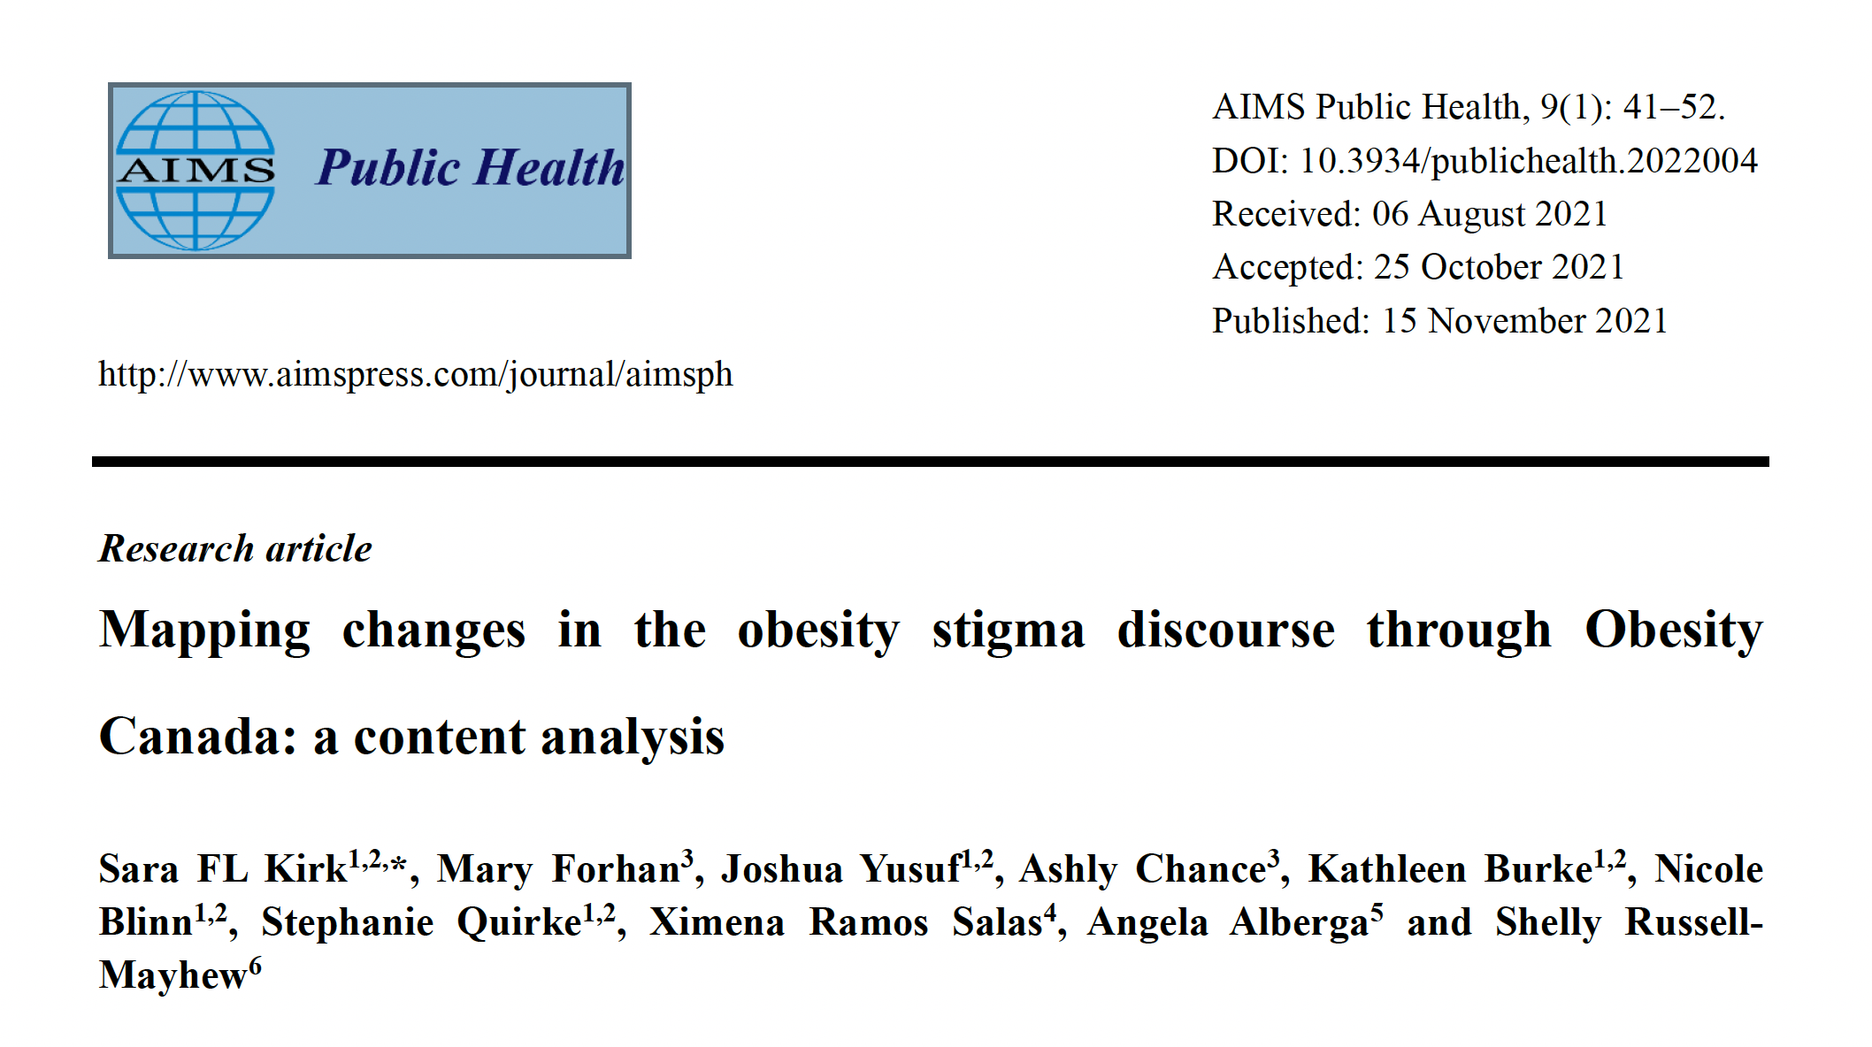
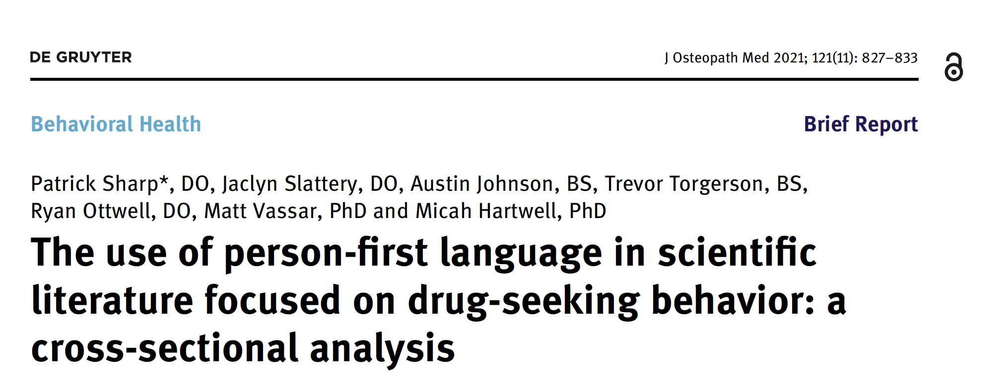
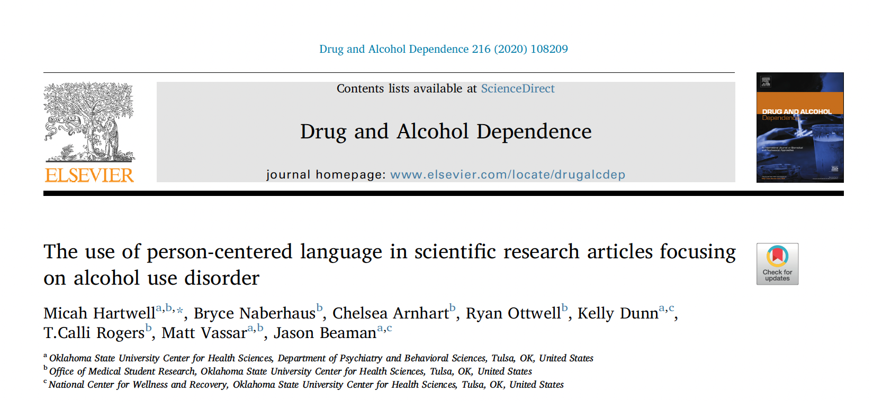

Slide 28

The European Society of Human Genetics is a non-profit organization that promotes research, facilitates communication and encourages best practice in applications of human and clinical genetics.
The society organizes the annual European Human Genetics Conference and publishes the European Journal of Human Genetics, public and policy statements
3,000 members - largest professional organization of its kind in Europe
3,000 – 4,500 participants at the annual conference

Slide 29
Our objective is to analyse the use of person-first / identity-first language in genetics research
175,000 abstracts
across 20 years
natural language processing methods
explore language evolution across time & identify potential influencing factors
Pilot study looking at data focused on *autism*

Slide 30
Natural language processing pipeline
31 .pdf files
Acquire original files
Convert .pdf to .txt
All text from .pdf into one line
NLP
Frequency counts
Remove irrelevant pages (cover page, adverts, index, etc.)
Split line by abstract marker
Subset abstracts with keywords 173,995 abstracts -> 1721 abstracts
Examine contexts
Notes:
31 .pdf (some years have 2 files, e.g. one for presentation abstracts and one for poster abstracts)
Semi-manual process to remove irrelevant pages (e.g. remove the indices, cover pages, etc.)
Convert .pdf to .txt files
Split .txt file into abstracts by delimiters 167336
Find all abstracts that contain keywords 1694

Slide 31
Person-first examples from ESHG
adolescents with asd
allele with autism
association with asd/autism
boy(s) with (ideopathic) asd/autism
brother(s) with asd/autism
cases with autism
child(ren) with (ideopathic/simplex/syndromic)
asd/autism
cohort with autism
cousin with asd/asperger
deletion with autism
disability with asd
disorder with autism
duals with asd/autism
efficiency with autism
epilepsy with or without autism
families with asd/autism
female with autism
genes with autism
girl with (severe) autism
individual(s) with (syndromic) asd/autism
inositol with autism
male with autism
overlap with autism
pathway with autism
patient(s) with (ideopathic/regressive/syndromic/non- syndromic/isolated) asd/asperger/autism
people with asd/autism
proband(s) with asd
risk with autism
siblings with asd/autism
subject(s) with asd/autism
syndrome with autism
testing with diagnosed asd
trios with asd
twins with autism

Slide 32
Identity-first examples from ESHG
asperger autism
(related) gene(s)
autosomal dominant disorder
basque sample
behavior(s)
boy/girl
brain(s)
brother
candidate
case(s)
causing
cggs
child(ren)
cohort(s)
communication
comorbidity
conditions
dataset(s)
diagnosis
disease
disorder(s)
disturbed function
(ethnic) population(s)
etiology
families
features
forms
functional studies
genetic variants
genetics
germline
group(s)
heritability
heterogeneity
higher load
image
individual(s)
inheritance
introduction
male
microcephaly
multigenic panel
multiplex
ostium
panel(s)
passivity
pathogenesis
pathology
(unrelated) patient(s)
pheno pathways
phenotype(s)
presentations
probands
pulmonary
quartets
regression
results
risk
sample(s)
secundum
sleep
small genomic deletions
sons
spectral disorders / spectrum
strategy
subject(s)
susceptibility
symptom(s)
syndrome(s)
technique
theadrenal cortex
trait(s)
valve
variants
variome

Slide 33
Implications
Conversation beyond mere semantics
Societal perceptions, public policy, clinical practice, research directions
Notes:
The language that we use shapes our understanding of the world around us

Slide 34
Any questions?
Notes:
The language that we use shapes our understanding of the world around us

Slide 35
Thank you.

